Slide 1
Physical exercise form correction using video processing
RNS INSTITUTE OF TECHNOLOGY
BENGALURU - 98
DEPARTMENT OF INFORMATION SCIENCE & ENGINEERING
Final Year Project Work Presentation
Nikita Pyati
USN: 1RN19IS095
Rohan Sanjay Savalgi
USN: 1RN19IS121
Sachin K Rao
USN: 1RN19IS127
Vineet K S
USN: 1RN19IS175
Guide
Ms. Sunitha K
Asst. Prof, Dept of ISE, RNSIT
Panel Member Name
Dr. Mamatha G
Associate Prof, Dept of ISE, RNSIT

Slide 2
ABSTRACT
The importance of the way human beings conduct their health can result in numerous benefits and prevention of weight problems, that may successfully lessen the threat of loss of life.
Working out at home is an opportunity to make fitness accessible without requiring lots of equipment. However, it has its drawbacks such as a confined access of fitness know-how, which can lead to severe injuries.
Our solution uses the MediaPipe library which is trained on the InfiniteRep dataset and fine-tuned for real-time form detection and correction. By using this product, fitness enthusiasts can get accurate and real-time information about their exercise technique, which can help them improve performance and prevent injury.

Slide 3
Introduction
This research focuses on developing a real-time system to detect and correct physical exercises which mainly include lunges, bicep curls, push-ups and leg extensions using video processing techniques.
Posture correction is essential for maintaining good health and preventing various health problems. Poor posture can lead to muscle imbalances, joint pain, and decreased mobility, among other issues.
The dataset used for training is InfiniteRep, which is a synthetic, open-source dataset for fitness and physical therapy (PT) applications.
To carry out this work, we used two main libraries, MediaPipe and OpenCV.

Slide 4
Introduction
The model compares the movements to a database of correct exercise forms and provides feedback on areas where the user’s form needs improvement.
This system is trained on the InfiniteRep dataset before being used to provide feedback to the user on areas where their form needs improvement, such as adjusting their posture or modifying their movements.
The feedback is presented in a clear and intuitive way, using visual cues and text prompts.

Slide 5
LITERATURE REVIEW
 | Heading/year | Model | Datasets | Performance measure | Values
1 | Assessing human motion during excercise | Hidden Markov model(HMM), Dynamic time wrapping(DTW) | Motion caption systems,Mocap | Accuracy | 67-86%
2 | Physical exercise form correction | Convolutional neural networks | Images from frontal camera | Accuracy | 65% and above
3 | Human pose estimation in the field of sport an physical | CNN-Convolutional neural networks | Dancing and sports datasets(MADS),HPE,Mocap | OKS,PCK,RMSE

Slide 6
LITERATURE REVIEW
4 | Machine learning technique for identification of yoga poses | SVM,Logistic regression,naïve bayes,KNN,Random forest | Yogi dataset | Accuracy | 94.28%
5 | Detecting unseen anomalies in weight training excercise | Chain rule on change of position function | Motion sensor data | Mean, standard deviation | 94%
6 | Posture correction using human pose estimation | CNN | MPII | Accuracy

Slide 7
ANALYSIS
Problem Identification
Certain types of exercises can be challenging for new users. You may face problems like not being sure how to perform the exercises or how to engage your muscles. Without a professional to correct your form and technique, how can you tell if you are performing these exercises correctly?
If the workouts are too difficult to keep up with, you may need to try a easier routine. Walking or jogging 2 – 3 times a week does not necessarily mean that you are able to follow home workouts. Not all exercises are equal as the skills required are vastly different.
Having no motivation to keep on working out everyday or frequently can be a very huge problem when the user is over-worked, irritated, sore. Even when there are far too many distractions to the user like television and the social media to waste time.

Slide 8
ANALYSIS
Objectives
Fitness is important in people’s lives. Good fitness habits can improve cardiopulmonary capacity, increase concentration, prevent obesity, and effectively reduce the risk of death.
The system has to be consistent in detection of wrong postures which might lead to injuries, which finally can lead to improper gains.
Helps in tracking sets and repetitions of exercise. Provides motivation by tracking timely achievements. Tracking sets and repetitions can help users to monitor progress and adjust their workout routine as needed.
Helps in maximizing consistent gains. By tracking progress and providing consistent feedback, users can make adjustments to their workout routine in order to maximize gains and improve overall fitness.

Slide 9
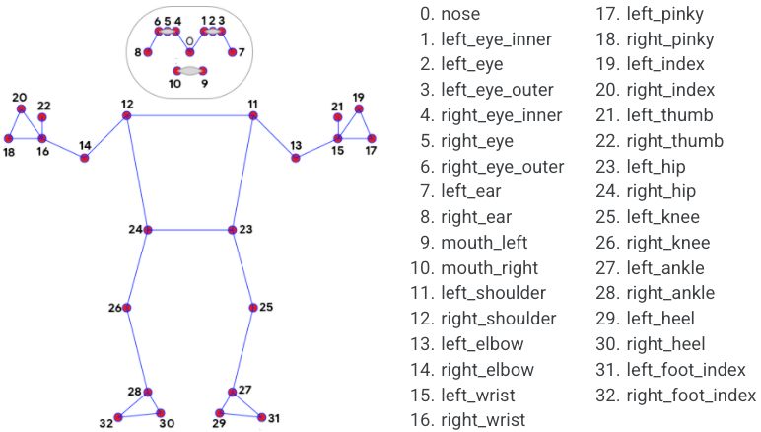
Analysis
Methodology

Slide 10
Analysis
Methodology
The video sample is first gathered by MediaPipe’s calculator graphs which are used to process streams of video and audio frames by receiving successive packets with increasing timestamps.
The solution utilizes a two-step detector-tracker ML pipeline.
Using a detector, the pipeline first locates the person/pose region-of-interest (ROI) within the frame.
The tracker subsequently predicts the pose landmarks and segmentation mask within the ROI using the ROI-cropped frame as input.
A skeleton of the region of interest is created by MediaPipe which is trained on the Objectron dataset.
Finally, the created skeleton is checked manually for each exercise by defining the joint angles required for it to be executed correctly.

Slide 11
Analysis
System Requirement Specification
HARDWARE REQUIREMENTS:
Processor: Intel i5 (any processor)
Processor Speed: 2.4 GHz
RAM: 4 GB Monitor
Resolution: 1024 x 768 or 1336 x 768 or 1280 x 1024
SOFTWARE REQUIREMENTS:
Operating System: Windows 7 or above
Web browser: Google Chrome
Software: Jupyter Notebook or Pycharm IDE or Google Colab
Programming Language: Python

Slide 12
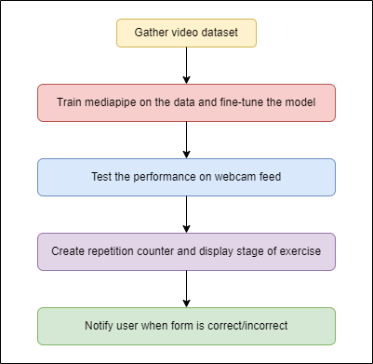
System Design
Project workflow

Slide 13
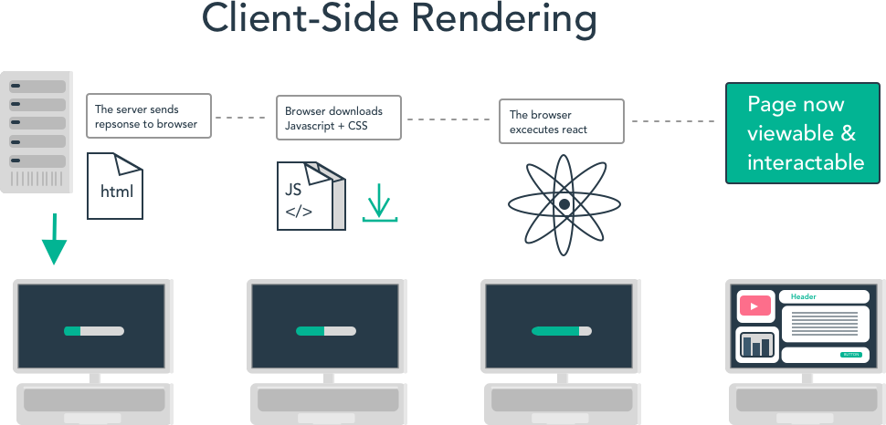
System Design
Web architecture

Slide 14
Implementation
Dataset-
The dataset used for training is InfiniteRep, which is a synthetic, open-source dataset for fitness and physical therapy (PT) applications.
It includes 1000+ videos of diverse avatars performing multiple repetitions of common exercises.
It includes significant variation in the environment, lighting conditions, avatar demographics, and movement trajectories.
The dataset features 100 videos per exercise, spanning 5 to 10 repetitions each (1,000 videos total).
The main features include working under diverse lighting conditions, varied body shape, skin tones, and clothing.

Slide 15
Implementation
The estimated joints and body parts are then checked for correctness by the use of functions which calculate the angles between them based on the specific exercise being performed.
The numeric value of the angle in degrees is altered such that any angle greater than 180 is reset to 0.
For the purpose of this work, we have considered four different exercises, which are push-ups, leg extensions, lunges and bicep curls.
If the user's form is incorrect, the system provides real-time feedback on where the user is making a mistake.
This feedback is in the form of visual cues such as highlighting the correct and incorrect body positions and displaying a text message on how to correct it.

Slide 16
Implementation
In order to effectively locate the source of the incorrect posture for each exercise, we only consider the landmarks and connections between them that are relevant to that particular exercise.
When the user’s form is deemed correct, the connections are displayed in green colour along with a message reiterating that it is correct. On the other hand, when the user’s form is incorrect, the connections are displayed in red with a message reiterating the same.
The number of repetitions performed by the user along with their current stage of exercise is also displayed.
When the angle between the relevant joints for a given exercise cross a certain threshold, the repetition counter is incremented and the stage of the exercise is updated.

Slide 17
Implementation
While applying the model to real-time webcam video feed, we process the feed every 10 frames to save the computation of every single frame.
By default, the input feed received from OpenCV is in the Blue-Green-Red (BGR) format.
However, MediaPipe can only process Red-Green-Blue format.
To solve this problem, we convert the feed from BGR to RGB using OpenCV’s inbuilt functions.

Slide 18
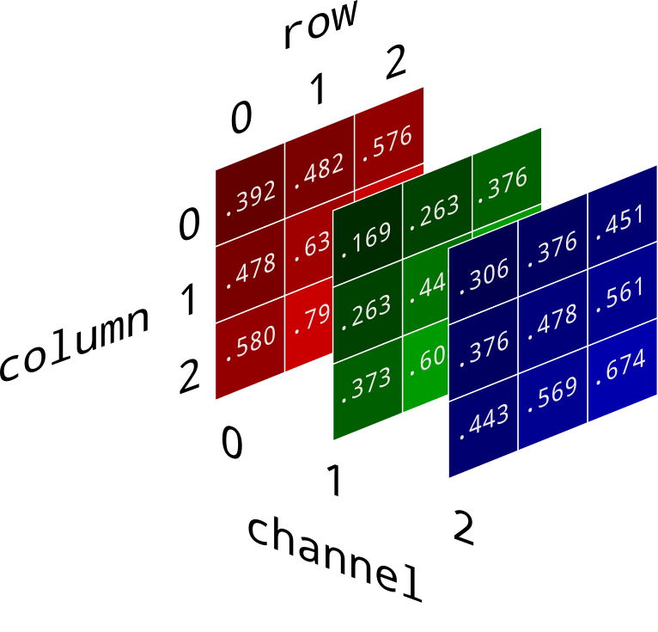
Implementation

Slide 19
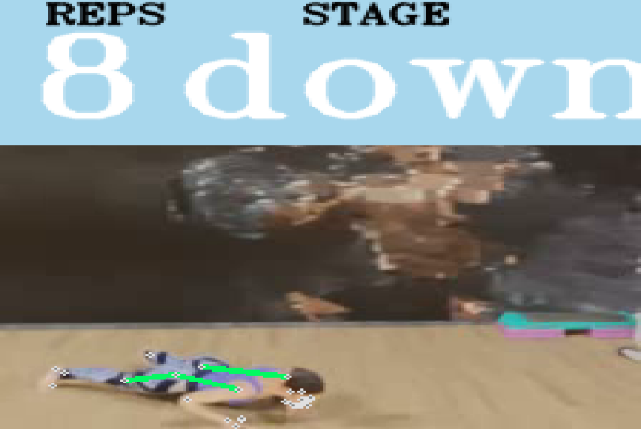
Discussion of Results
The figure below shows the demonstrator performing a push-up with correct form with the angle between the knee, elbow and hip being within a certain threshold level.

Slide 20
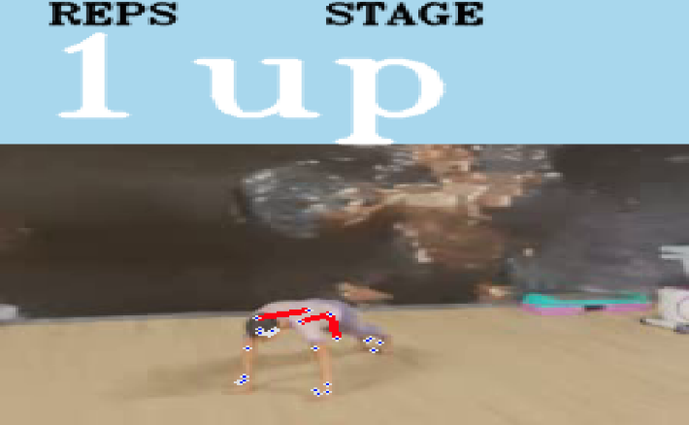
Discussion of Results
This figure shows the demonstrator performing a push-up with an incorrect posture with the angle exceeding the threshold value which can lead to potential harm to a real user if remained undetected.

Slide 21
Discussion of Results
The results of our evaluation showed that the MediaPipe model used in this system achieved a high accuracy rate, with an MPJPE of 3.2 cm and a PCK of 95.6% on the InfiniteRep dataset.
This indicates that the model is able to accurately estimate body poses and key joints in exercises, making it well-suited for use in a physical exercise form correction system.

Slide 22
National Conference Paper
The National Conference Paper can be found at-
https://drive.google.com/file/d/1uqOG6gX6oiBpHcGUYhiHOb7j7mWwVGnC/view?usp=sharing

Slide 23
CONCLUSIONS
By providing accurate and real-time feedback on their form, users can correct their posture and achieve better workouts.
The MediaPipe model used in this system has been fine-tuned for real-time pose estimation and achieved high accuracy on the InfiniteRep dataset.
The system has the potential to be expanded to other exercises and sports, making it a valuable tool for fitness enthusiasts and athletes.
The project focuses to display timely and regular achievements and milestones when a certain number of workouts are completed accurately and correctly.

Slide 24
FUTURE ENHANCEMENTS
Expanding the system to include a wider variety of exercise types could increase the potential user base and provide more comprehensive feedback on exercise form.
Integration with AI language models specifically Text-to-Speech could provide users with voice-based feedback on their exercise form, enhancing the user experience and providing a more natural interaction with the system.
Integrating the system with wearable devices, such as fitness trackers or smartwatches, could provide additional data to improve the accuracy of exercise form detection and correction. For example, wearable devices could provide information on heart rate or muscle activation, which could be used to validate exercise form.
Integration with virtual reality could provide a more immersive experience for users, allowing them to perform exercises in a virtual environment with real-time feedback on their form.
Integration with a social platform could provide users with additional motivation and accountability. Users could share their progress and workout plans with friends or join virtual fitness groups to engage in friendly competition.

Slide 25
References
[1] Cristian Militaru, Maria-Denisa Militaru, and Kuderna-Iulian Benta. Physical exercise form correction using neural networks. In Companion Publication of the 2020 International Conference on Multimodal Interaction, pages 240–244, 2020.
[2] Yash Agrawal, Yash Shah, and Abhishek Sharma. Implementation of machine learning technique for identification of yoga poses. In 2020 IEEE 9th international conference on communication systems and network technologies (CSNT), pages 40–43. IEEE, 2020.
[3] Aritz Badiola-Bengoa and Amaia Mendez-Zorrilla. A systematic review of the application of camera-based human pose estimation in the field of sport and physical exercise. Sensors, 21(18):5996, 2021.
[4] Abdul Hannan, Muhammad Zohaib Shafiq, Faisal Hussain, and Ivan Miguel Pires. A portable smart fitness suite for real-time exercise monitoring and posture correction. Sensors, 21(19):6692, 2021.
[5] Muhammad Usman Ashraf, Abdul Hannan, Sehrish Munawar Cheema, Zahra Ali, Abdulraheem Alofi, et al. Detection and tracking contagion using iot-edge technologies: Confronting covid-19 pandemic. In 2020 international conference on electrical, communication, and computer engineering (ICECCE), pages 1–6. IEEE, 2020.

Slide 26
QUESTION AND ANSWER

Slide 27
THANK YOU

